Slide 1
Fatafut Mangwaen
Group members
Rizwan Ahmad
Shaghil Ashfaq
Ubaid-Ur-Rehman
Junaid Akram
Supervisor
Sir Fahad Khan
Notes:
Rizwan

Slide 2
Overview
Introduction
Problem Statement
Proposed Solution
Concept Diagram
Benchmarking
Features
Block Diagram
Functional Requirements
Non-Functional Requirements
Tools and Technology
Potential Impact on Society
Reference

Slide 3
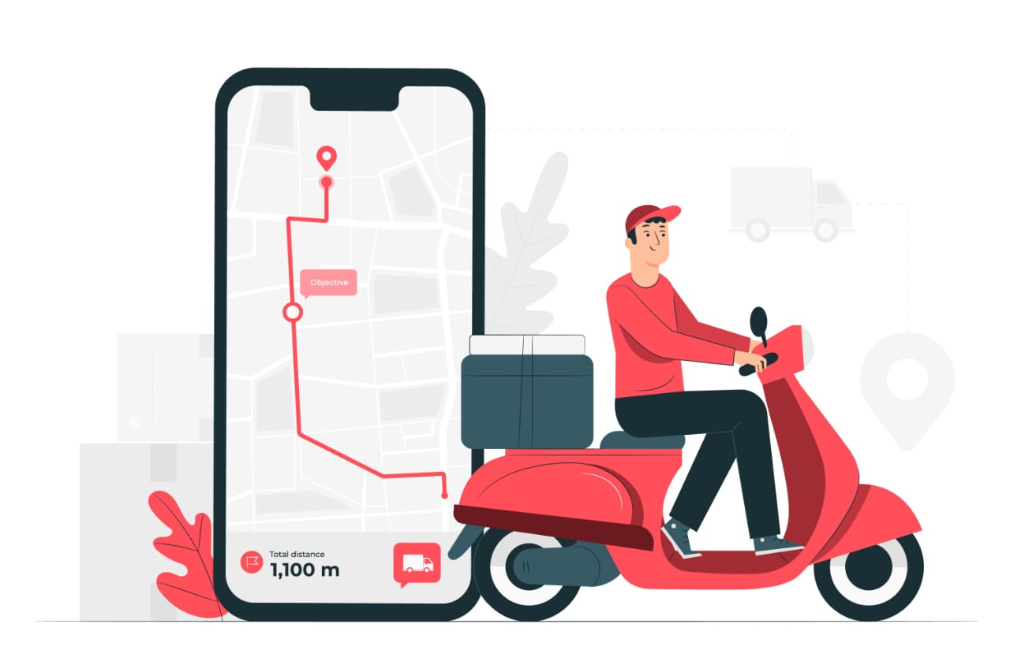
Introduction
Fatafut is a home delivery system which allow delivery of all category of products.
Groceries, food , books and many more.
Table reservations booking system.
Restaurants and different businesses can create a profile on this system.
Fatafut will have both android and web versions.
There will be four modules super admin, business owner, delivery boy and customer.

Slide 4
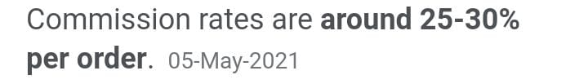
Problem Statement
There are different applications which provide specific features like some apps provide only food delivery and some provide groceries etc.
Incomplete orders.
Less competition in market which create Monopoly.
More time needed to buy things physically.
Covid-19.

Slide 5
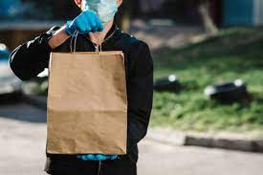

Proposed Solution
We are providing a combine virtual marketplace where business owners can register their business and sell products.
Customer will have image proof of product.
We will facilitate our businesses owners and customers with low commission. It will give competition in market.
As we are providing single platform, so people can save their time.
People will be able to shift their business online.

Slide 6
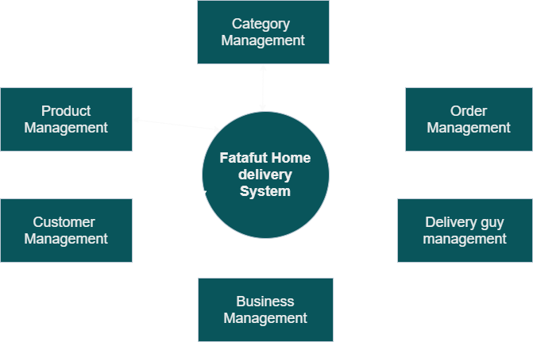
Concept Diagram

Slide 7

Benchmarking
Features | Fatafut Home Delivery | Foodpanda | Food Genie | Cheetay
Live tracking of delivery boy
Table reservation in restaurant
Maximum category of products.
Pick and drop
Both web and mobile versions

Slide 8


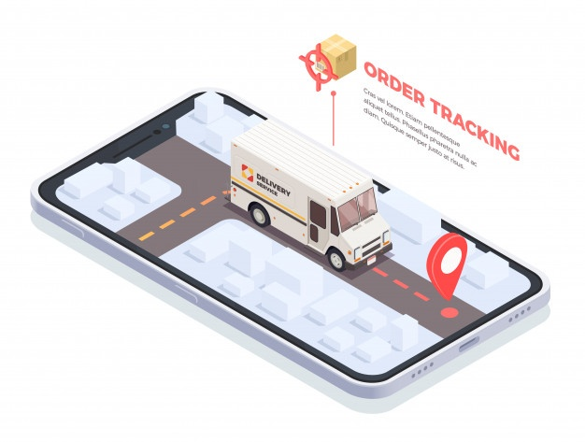
Features
Search
Order booking
Live tracking
Live chat
Table reservation
Businesses (Categories)
Payment methods
Alerts
Search shift
Cancel order
Product management
Order management

Slide 9

Features
Business analytics
Pick and drop
Businesses registration
Wallet

Slide 10
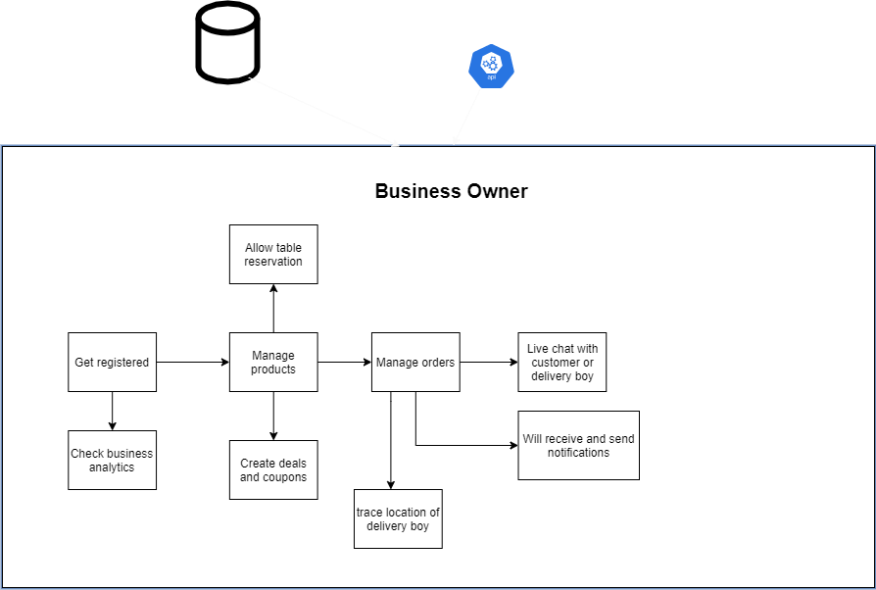
Block Diagram

Slide 11
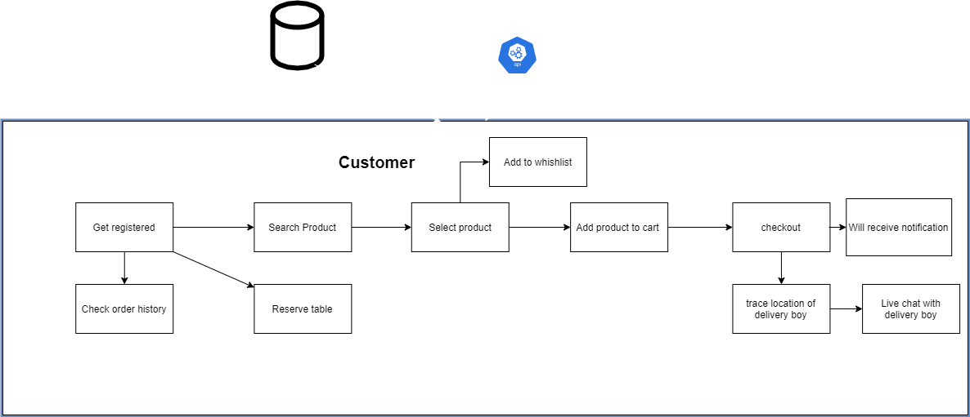
Block Diagram

Slide 12
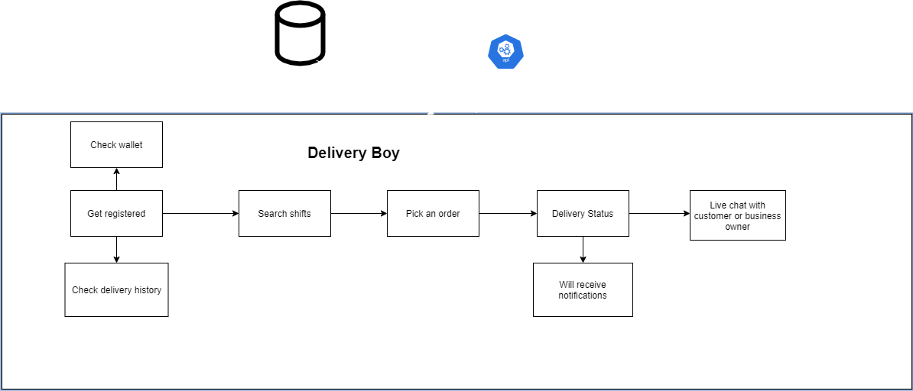
Block Diagram

Slide 13

Functional Requirement
Account creation
Verification
Authentication (Login)
Business registration.
Search .
Select item.
Table reservation.
Add to cart
Add category
Live tracking.

Slide 14
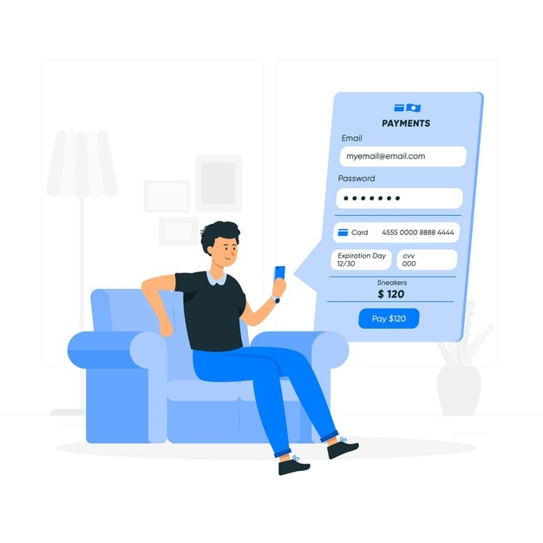
Functional Requirements
Live chat.
Order management
Product management
Business analytics
Payment/wallet

Slide 15

Non-Functional Requirements
Authentication time minimum 1 seconds.
Search product time minimum 1 seconds.
Payment process time minimum 5 second.
App will be portable in any android phone.
Website will be accessible .
Web version will be responsive.
Both web and android versions will be portable.
Maximum usability.
Easy to maintain.
24/7 service available for all orders.
Data of users will be secure.

Slide 16

Tools and Technology Used
Technologies
Php
Html
Bootstrap
Css
Javascritp
Ajax
Java
API
Google map

Slide 17

Tools and Technology Used
Tools
Xampp
Phpmyadmin
Mysql
Vscode (editor)
Atom (editor)
Draw.io & Creately (diagrams)
Adobe Xd $ Just-in-mind (prototyping)

Slide 18

Potential Impact on Society
Customer Experience.
Job opportunities.
Minimization of time.
Decrease Monopoly.
Businesses from home.

Slide 19
Reference
https://www.foodchow.com/Features%20
https://www.restolabs.com/blog/crucial-impact-online-ordering-system-restaurants%20
https://www.irjet.net/archives/V7/i4/IRJET-V7I4455.pdf%20
https://measuringu.com/food-delivery-benchmarks-2021/
https://www.freepik.com/free-vector/

Slide 20
Thanks Any Question?

